Slide 1

`
FisheyeDet: A Self-Study and Contour-Based Object Detector in Fisheye Images
T. Li, G. Tong, H. Tang, B. Li, and B. Chen, “FisheyeDet: a self-study and contour-based object detector in fisheye images,” IEEE Access, vol. 8, pp.71739-71751, April 2020.
Presenter: Ashish Kumar
Advisor: Prof. Yo-Ping Huang

Slide 2
CONTENTS
Proposed work
Introduction
The proposed methodology
Experiments and results
Conclusion

Slide 3
PROPOSED WORK
Authors proposed here propose a self-study and contour based object detector in fisheye images named FisheyeDet.

Slide 4
INTRODUCTION
Fisheye cameras owing to their large field of view (LFOV) have attracted diverse attention from both technical experts and the public in general.
Due to providing rich visual information they cover a wide variety of applications ranging from generating the contents of AR or VR, improving the performance of intelligent robot vision systems, to reducing the complexity of perception systems.

Slide 5
Object Detection In Fisheye Images
Distortion Correction Based
LFOV Image Based
Image wrapping encompassing the correction model plays key role in processing
Try to design location based convolutional kernels or adopt heuristic rules for extracting distortion features

Slide 6
Drawbacks:
Building unified fisheye distortion model is impossible because of intrinsic camera parameters and various lens distortions.
Rectangular bounding boxes cannot provide relatively accurate information in fisheye images.

Slide 7


Slide 8
Authors propose FisheyeDet with the basic aim :
Adaptively extract valid distortion features.
Precisely identify predictable boundary boxes.
For extraction of features no-prior fisheye representation method is developed to create the feature pyramid for the object detection purpose from the fisheye images.
A distortion shape matching strategy is used for the boundary boxes which invoke irregular quadrilateral boundary boxes precisely to localize all kind of distorted objects in the fisheye images.

Slide 9
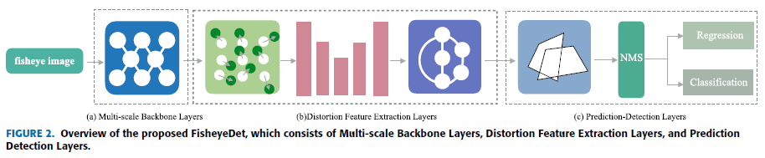
ARCHITECTURE

Slide 10
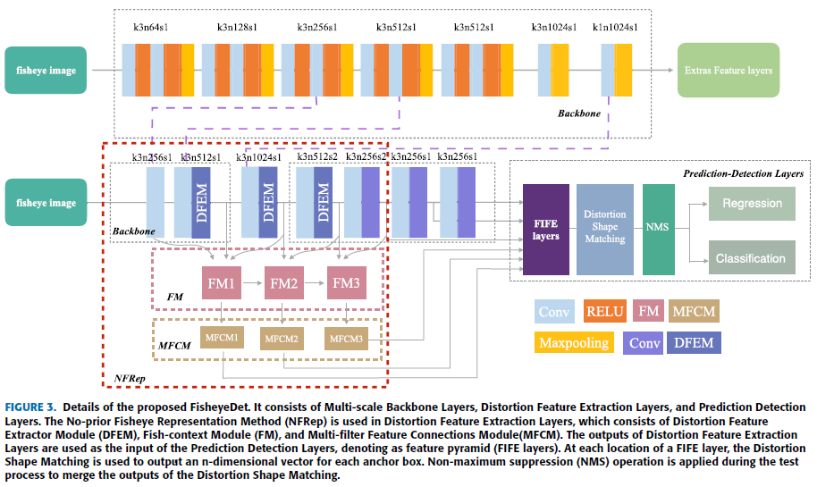

Slide 11
NO-PRIOR FISHEYE REPRESENTATION METHOD
Distortion Feature Extractor Module
Authors employed the conv4_3 and conv7 of VGG-16 reduced backbone as parts of feature extraction layers and add several convolutional layers as the other feature extraction layers.
Traditional convolutional unit - samples the input feature maps at a fixed location.
Deformable convolutional blocks – achieve better receptive fields that cover objects in fisheye images.

Slide 12

Deformable convolution consists of two steps:
Sampling over the input feature map x, with an offset Δp_{n}.
(2) Weighted summation of sampling points with a weighting coefficient w.
For each location p₀ on the output feature map y.
Where, R is a grid which defines the receptive field size and dilation.
p_{n} represents each location in R.
The offsets Δp_{n} can be learned from the preceding feature maps via additional convolutional layers.

Slide 13
Fish-Context Module
U-Net – U-shaped architecture consists of a contracting path to capture context and a symmetric expanding path that enables precise localization.
So the high-resolution features from the contracting path are combined with the upsampled output.
Fish-context Module fuses features from different levels by combining low-resolution high-level features with high-resolution low-level features.

Slide 14
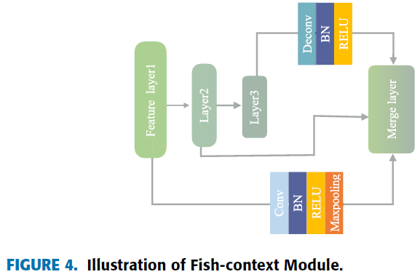
Input - three layers with different scale.
Deconvolutional operation – expanding the lower resolution layer.
Convolutional operation - reduce higher resolution layer before fusing features.
Batch normalization layer and RELU layer are added after each convolutional layer and deconvolutional layer.

Slide 15
Multi-filter Feature Connections Module
Generates multi-scale features from a single level layer by placing a group of convolutional operations with different convolutional kernels.
This module take features generated by fish context module as input this allows each multi-filter feature connections module to reap the multi-level multi-scale features these features are more representative.
To explicitly extract the distortion features of different layers authors design three types of multi filter feature connections modules.

Slide 16
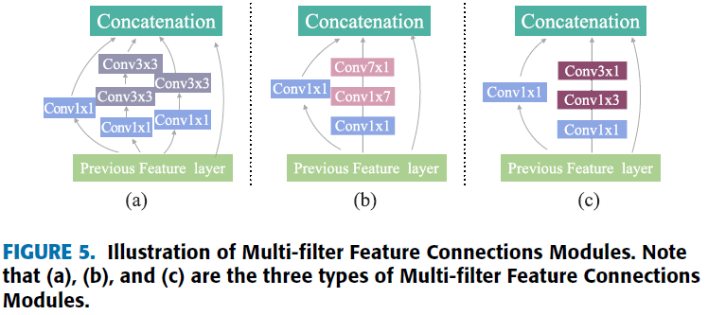
Noticing that before 3×3 convolutions and 7×7 convolutions, a 1×1 convolution is used to compute dimension reductions. This method significantly reduces the parameter count.

Slide 17
DISTORTION SHAPE MATCHING
IRREGULAR INTERSECTION OVER UNION (IoU) COMPUTATION
8-points representation method is a contour-based way to describe the objects in fisheye images.
Overlap formed by this method is a polygonal area, so the previous methods of IoU computation between the ground truth box and every anchor box may lead to an inaccurate IoU.
Authors put forward a simplified and statistical based calculation method to compute the irregular IoU.

Slide 18
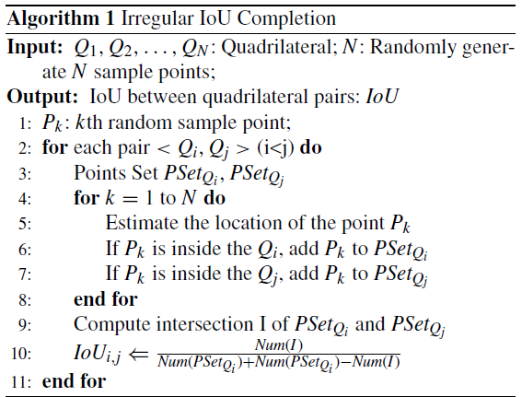
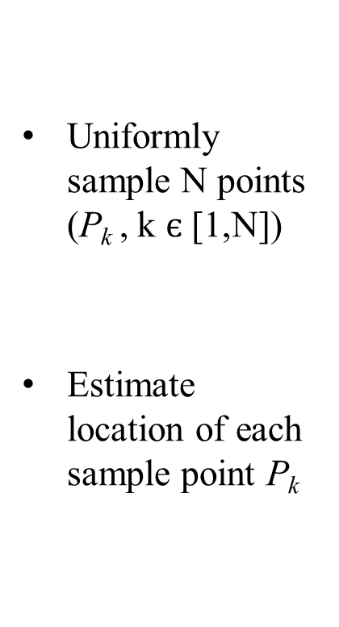
Uniformly sample N points (P_{k} , k $є$[1,N])
Estimate location of each sample point P_{k}

Slide 19

Q_{i} is a convex quadrilateral.
Vector Cross Product method to estimate the point P_{k} whether it is inside an irregular quadrilateral or not.
where B, C, E, and G are the four vertices of a quadrilateral
P_{k} is a random sample point
If four formulas are established then the point P_{k} is inside the quadrilateral.

Slide 20
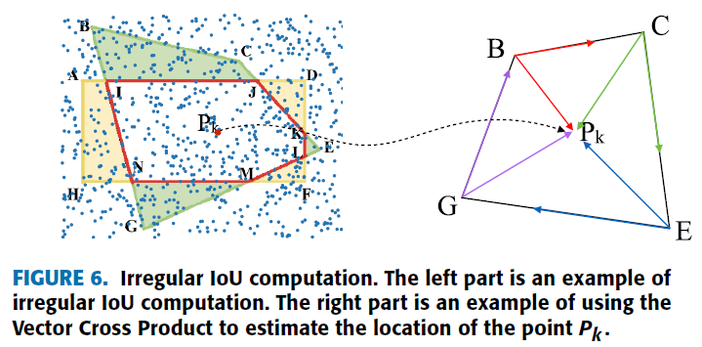

Slide 21
LEARNING OF IRREGULAR QUADRILATERAL BOUNDING BOXES
Authors adopted 8-points (x1, y1, x2, y2, x3, y3, x4, y4) to annotate the distorted ground truth box instead of the conventional 4 points.
Calculating IoU between each anchor box and ground truth box the predictor can get the offsets from the best matched anchor box at each location.

Slide 22
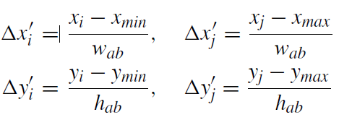
Let ground truth box gt = (x1, y1, x2, y2, x3, y3, x4, y4)
Anchor box is a rectangle denoted as: ab = (x_{min}, y_{min}, x_{max}, y_{max})
Calculate the width and height of the anchor box respectively w_{ab} = x_{max} - x_{min}, h_{ab} = y_{max} - y_{min}. Offsets are calculated as follows:
where i = 1, 3, j = 2, 4.
This is considered as a direct regression from a rectangle bounding box to the best matched quadrilateral ground truth box.

Slide 23
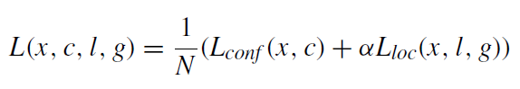
LEARNING
Loss function defined as:
x is the match indication matrix
c is the confidence
l is the predicted location
g is the ground truth location
N is the number of anchor boxes that match ground truth boxes

Slide 24
Match indication matrix x.
If i-th anchor box and the j-th ground truth box match according to the Distortion Shape Matching strategy then x_{ij} is set to 1, otherwise 0. Additionally α is set to 1.
Imbalance between positive and negative samples during training was taken care hard negative mining and focal loss.
The smooth L1 loss is for L_{loc,} the focal loss is for L_{conf}.
The training objective is to minimize this loss function.

Slide 25
EXPERIMENTS AND RESULTS
A) SYNTHESIZED DATASETS VOC-FISHEYE DATASET
Public datasets generic object detection, not specific for fisheye object detection.
Models based on pre-trained on the generic datasets are directly applied to the fisheye object detection task the results are often unsatisfactory.
Authors produce a synthesized training fisheye dataset based on an existing perspective image dataset PASCAL VOC(first public fisheye dataset).

Slide 26
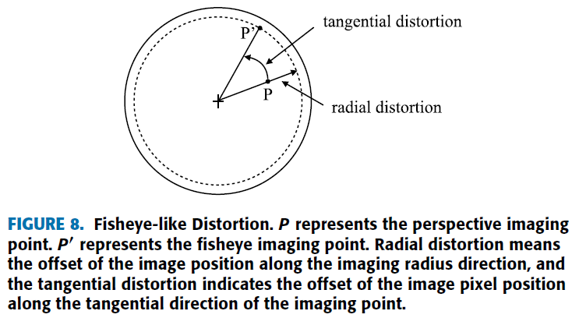
1) FISHEYE LIKE DISTORTION

Slide 27
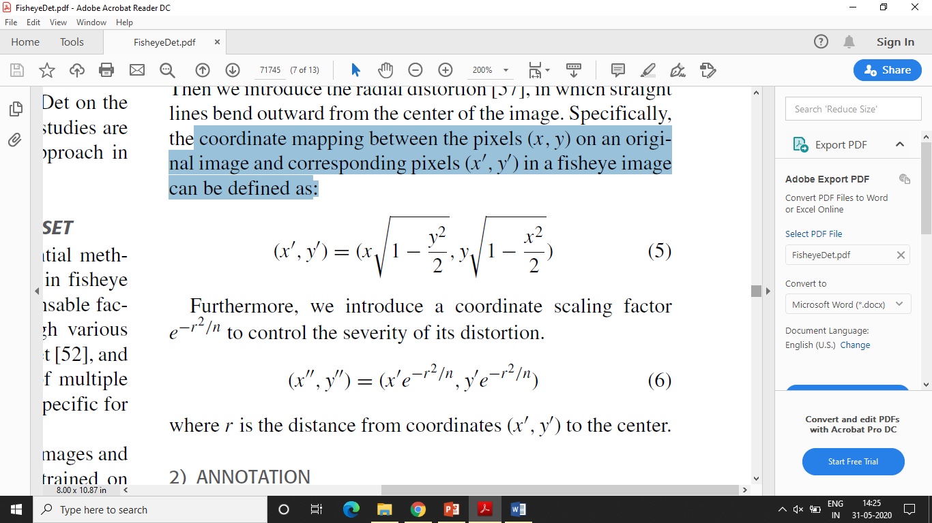
Visually approximate the appearance of fisheye images normalize the coordinates of the original images.
(0,0) represents the center and (± 1, ± 1) are the coordinates of four corners.
Radial distortion in which straight lines bend outward from the center of the image.
Coordinate mapping between the pixels (x,y) on an original image and corresponding pixel (x',y') in fisheye images defined as:
Corresponding pixels in fisheye image
Coordinate scaling factor to control the severity of its distortion.
R is distance from coordinates(x',y') to center.

Slide 28
2) ANNOTATION
49653 fisheye looking training images and 14856 testing images.
Precisely describe the object contour - irregular quadrilaterals to annotate the locations of objects.
The parameters are (x1, y1, x2, y2, x3, y3, x4, y4), where (x_{i},y_{i}) are the location of the four corners of the ground truth box.

Slide 29
3) FURTHER DETAILS OF VOC-FISHEYE
Original image from the PASCAL VOC can be transformed into several of fisheye images by introducing different coordinate scaling factors.

Slide 30


Slide 31
B) IMPLEMENTATION DETAILS
VOC-Fisheye `trainval' dataset – training model.
Consists of 20 object categories each of which has the annotated ground truth location (8-points) and corresponding category information.
During training stage - input images are randomly cropped and resized to 300 × 300.
FisheyeDet is trained with stochastic gradient descent (SGD) optimizer with batch size 64.
Learning rate lr is set to 0.001 and the nesterov momentum to 0.9 with weight decay of 5 × 10⁻⁴.
Learning rate every 80 epochs decreases once.
Aspect ratios of anchor boxes set to 1, 2, 3, 5, 1/2, 1/3, 1/5.
Average precision (AP) used as an evaluation protocol for each object category and mean AP (mAP) computed over all object categories.

Slide 32
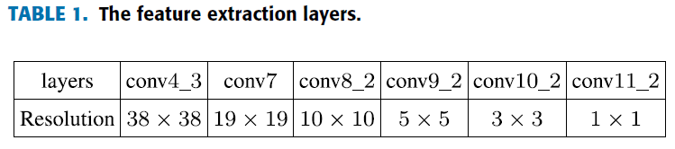
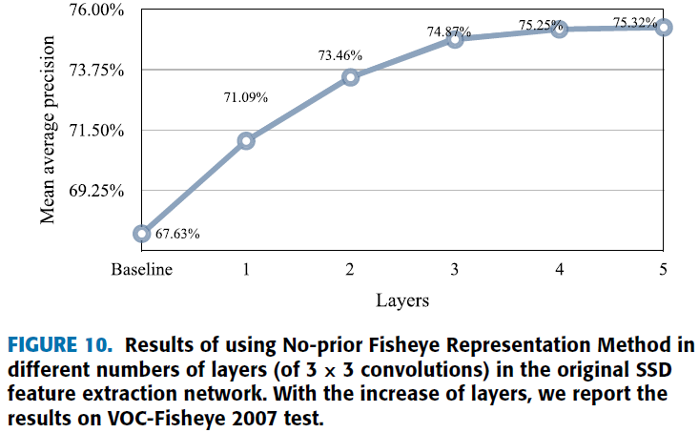
C) COMPARISON TO THE STATE-OF-THE-ART

Slide 33
The value of mAP steadily improves with the increasing layers.
The growth of mAP gradually decreases from 3.46% to 0.07% indicating the improvement saturates using 3 layers (conv4_3, conv7, conv8_2).
No-prior Fisheye Representation Method to the last three layers for training and testing.

Slide 34
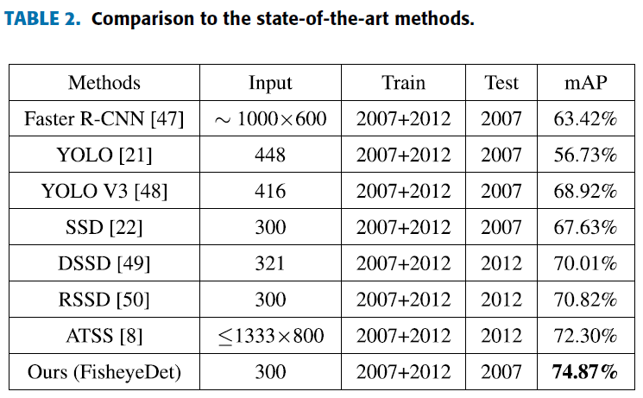

Slide 35
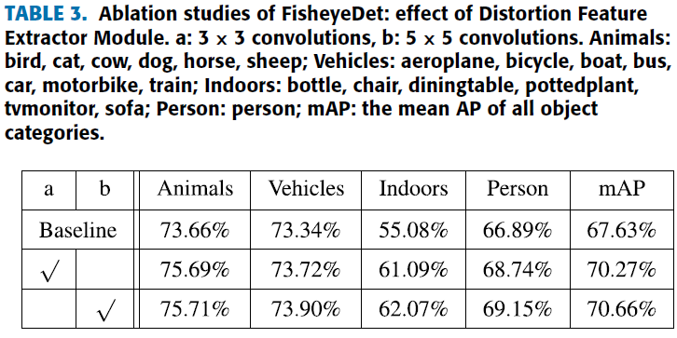
D) ABLATION STUDIES
Baseline is a simple detector based on the original SSD with 300×300 input size and VGG-16 reduced backbone.
1) NO-PRIOR FISHEYE REPRESENTATION METHOD
a: Distortion Feature Extractor Module
Indicating the effect of this module authors adopted two different forms (3×3 convolutions and 5×5 convolutions) in their detector.
Better mAP (3.03%) for the module with 5×5 convolutions
and less improvement in mAP (2.64%) for the module
with 3×3 convolutions.

Slide 36
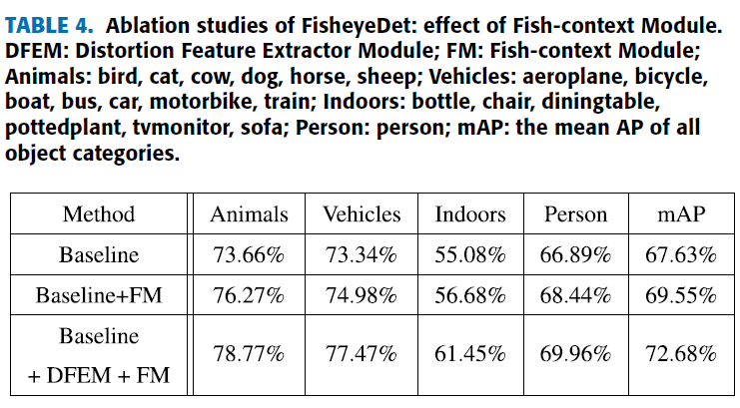
b: Fish-Context Module
Fish-context Module fuses features from different levels by combining high level features with low level features.
Gaining is improving from 67.63% to 72.68% which illustrates the effectiveness of joining
high-level features with the low-level features resulting in a
better representation of objects in fisheye images.

Slide 37
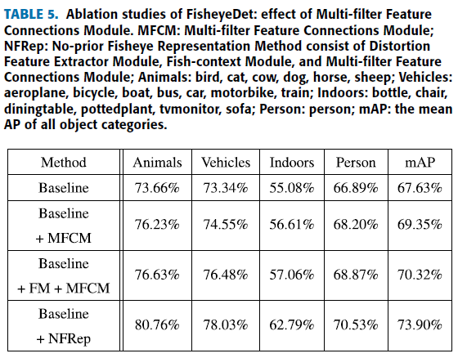
c: Multi-filter Feature Connections Module
Aims to generate multi scale features.
DFEM+ FM
mAP rises nearly 6.27%

Slide 38
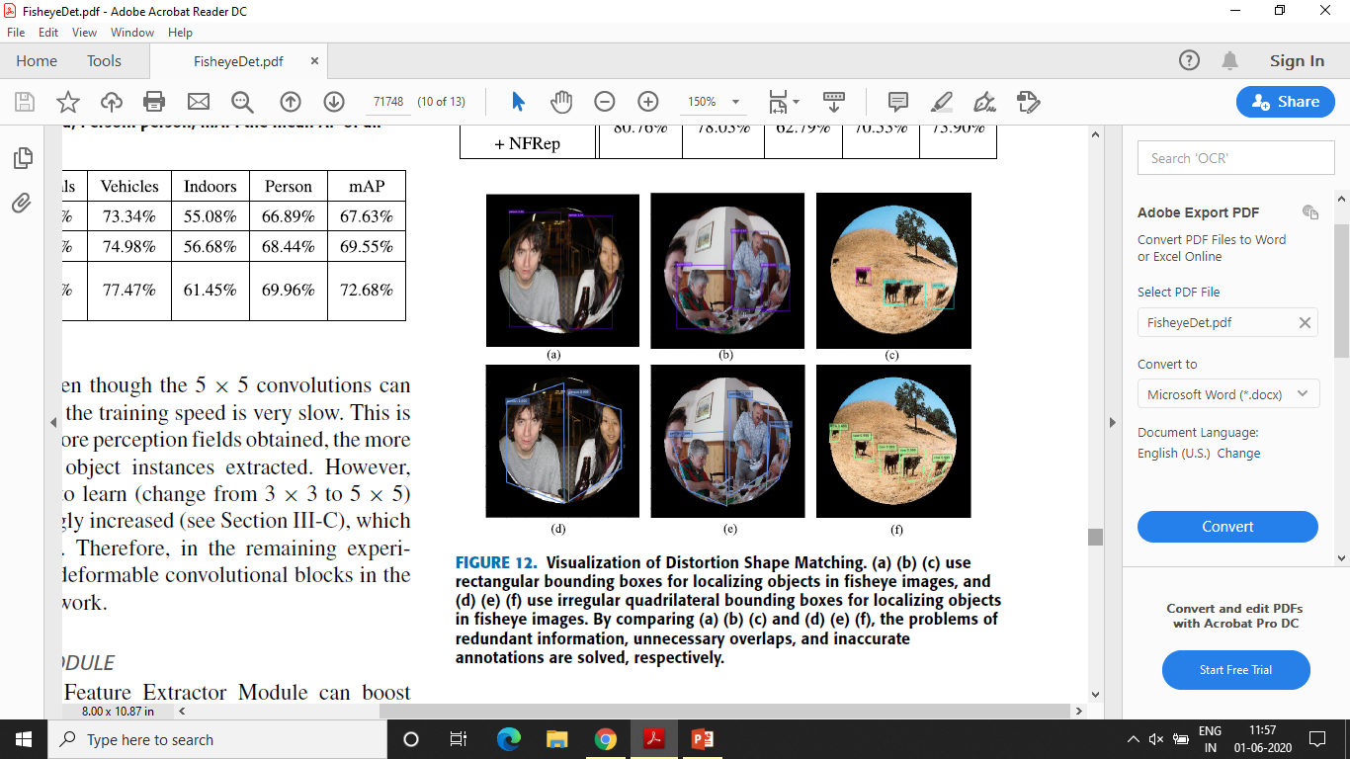
2) DISTORTION SHAPE MATCHING
Limited by rectangular bounding boxes such as redundant information, unnecessary overlaps and inaccurate annotations.

Slide 39
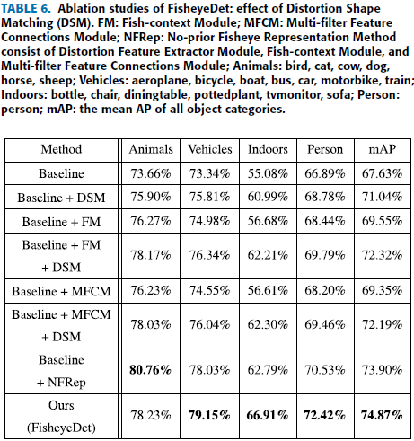

Slide 40
In order to further reinforce and confirm the superiority of method authors evaluated FisheyeDet on COCO-Fisheye dataset and the AP_{bbox} is boosted by 0.7% - 14.4%.
DATASET
COCO-Fisheye dataset constructed from the COCO dataset by using the fisheye production method.
354861 fisheye looking training images
15000 testing images
It consists of 80 object categories.
IMPLEMENTATION DETAILS (Same as mentioned on slide 31)

Slide 41
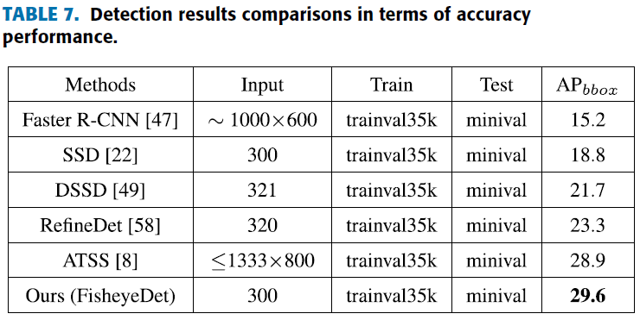
RESULTS

Slide 42
CONCLUSION
Due to the lack of benchmark fisheye datasets for the multi-class object detection task authors are on the first attempt to put forward the VOC-Fisheye dataset.
Experiments on this dataset show that FisheyeDet signicantly outperforms the state-of-the-art conventional methods.
The FisheyeDet allows arbitrary distorted input, keeps good generalization ability and shows higher accuracy.

Slide 43
Thank You

